Slide 1
LAB - 01

Slide 2
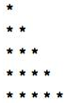
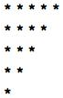
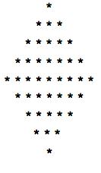
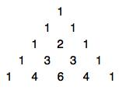
Task - 1
Write a program that will show the following outputs simply by using cout statements.
(a)
(b)
(c)
(d)

Slide 3
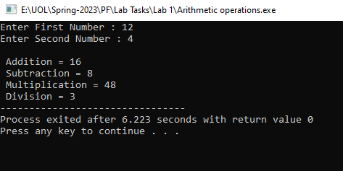
Task - 2
Write a C++ program to accept two numbers from the user and perform arithmetic operations on numbers.

Slide 4
Task - 3
Write a C++ program to accept SAP ID and student name from the user and display it on the screen. Use string, char and getline functions for student name variable to demonstrate the differences between char, string and getline function.

